Slide 1
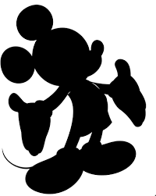
Disneyland
through the years

Slide 2
The Plan

Slide 3
Opening day
1955

Slide 5
1955

Slide 6
Five year anniversary
Mickey Mouse cutting a five foot cake in celebration
1960

Slide 7
Disney making some changes to the park
1961

Slide 8
The monorail at the base of the Matterhorn

Slide 9
Original Sleeping Beauty’s Castle
Early 1960s

Slide 11
15 Year Anniversary
1970

Slide 12
Adorable child hugging Pluto
Early 70s

Slide 14
Disneyland’s had 200 million visitors!
1981

Slide 15
Tower of Terror Introduced
1994

Slide 16
Fastpasses introduced
1999

Slide 17
California Adventure amusement park opens
2001

Slide 18
Disneyland as we know it

